Slide 1
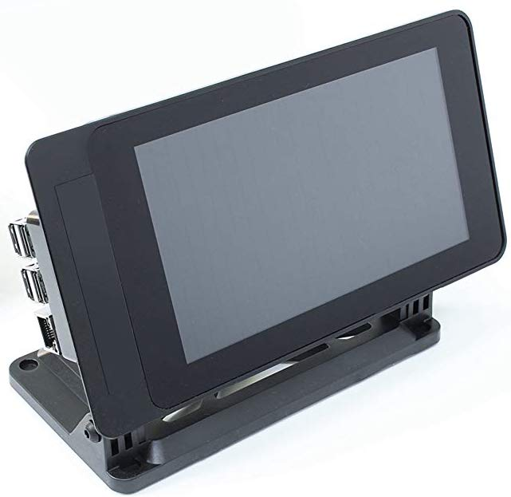
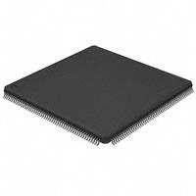
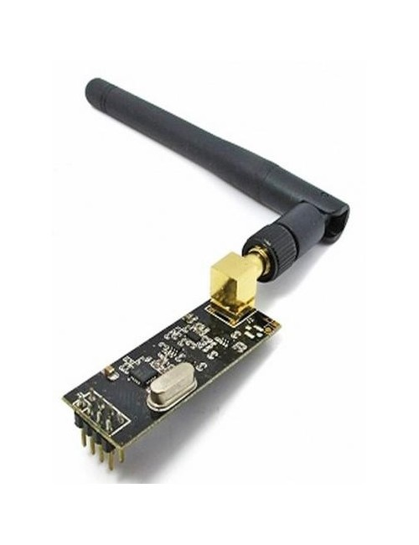


Cloud Control
Andrew Thompson | Reed Taylor| Brent Morada | Anna Lee
Background
PCB Design
Critical Hardware Components
Communicating with groups of people during an emergency situation is an extremely important and challenging task. The Cloud Control project aims to relay messages from a ground control system to a target audience under a drone without being physically present.
Ground Control System:
User interface running on Raspberry Pi touch screen with a micrphone
f
Drone Module:
PCB with speaker system mounted on hexacopter drone
Insert picture of
PCB
Raspberry Pi Ground Control System
Touch screen user interface which records audio via a microphone and transmits the audio samples through the NRF24 sending module.
LPC4088 Microcontroller
Main chip on the PCB which receives digital audio samples from the NRF24 receiving module and passes them to the audio codec.
User Interface
NRF24 Wireless Module
Wireless transmitters connected to both the ground control system and the PCB for sending/receiving audio samples
Caption and/or text (preferably bullet points)
Insert figure
Drone
Insert picture of drone
Audio Codec
Descirption
Describe key result (consider bullet point list).
Speaker System
Descirption
Software Design
Insert brief description of software
Caption and/or text (preferably bullet points)
Acknowledgements:
Special thanks to Phil Tokumaru, Yogananda Isukapalli, Brandon Pon, and Carrie Segal.

